Slide 1
Digital Portfolio
STUDENT NAME: M.Jeyakumar
REGISTER NO:212402365 NMID:22214053CAD1709ACAD448C726251670
DEPARTMENT: BCA
COLLEGE: AGURCHAND MANMULL JAIN COLLEGE/ MADRAS UNIVERSITY

Slide 2
PROJECT TITLE
DIGITAL PORTFOLIO USING FRONT END DEVELOPMENT

Slide 3


AGENDA
Problem Statement
Project Overview
End Users
Tools and Technologies
Portfolio design and Layout
Features and Functionality
Results and Screenshots
Conclusion
Github Link
3/21/2024 Annual Review

Slide 4

PROBLEM STATEMENT
Creating a professional digital portfolio website to showcase personal information, goals, skills, and projects. The challenge is to design it in a way that is user-friendly, visually appealing, and interactive.

Slide 5

PROJECT OVERVIEW
This project is a digital portfolio website for M. Jeyakumar, highlighting his skills in Java, C programming, editing, and social media presence. It includes sections like About Me, Goals, Projects, and Contact Form. The portfolio also demonstrates affiliate marketing experience and web development knowledge.

Slide 6

WHO ARE THE END USERS?
Recruiters and hiring managers looking for skilled candidates.
Clients seeking developers or collaborators.
Other professionals in the e-commerce and tech space.
General audience interested in personal portfolios.

Slide 7

TOOLS AND TECHNIQUES
HTML5 → Website structure.
CSS3 → Styling, layout, and responsive design.
JavaScript → Form validation and interactivity.
Affiliate Marketing Integration (Amazon).
SEO Optimization techniques for better reach.

Slide 8
POTFOLIO DESIGN AND LAYOUT
Header → Title and navigation bar.
About Me → Personal introduction and skills.
My Goals → Career and entrepreneurial aspirations.
Projects → Amazon affiliate website project.
Contact Form → Allows visitors to send messages.
Modern design with gradient backgrounds, rounded corners, and shadow effects.
8

Slide 9
FEATURES AND FUNCTIONALITY Smooth navigation bar. Clear sectioned layout (About, Goals, Projects, Contact). Contact form with JavaScript confirmation. Responsive design for different devices.

Slide 10
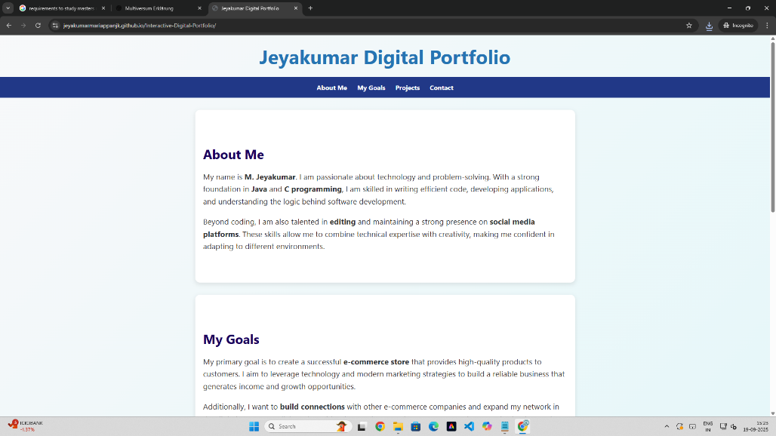
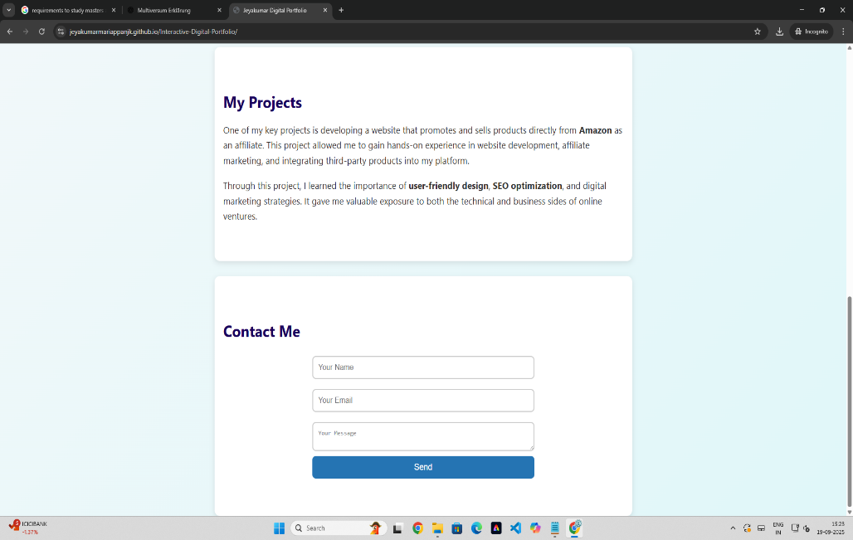

RESULTS AND SCREENSHOTS
3/21/2024 Annual Review
10

Slide 11
CONCLUSION
The digital portfolio effectively showcases skills, goals, and projects in a professional and creative way. It highlights both technical expertise (coding, web development) and business mindset (affiliate marketing, e-commerce goals). This project can be used as a stepping stone for career opportunities and online business ventures.
11

